Slide 1

Threat Intelligence and DLP
Understanding common points of synergy
Monty St John

Slide 2
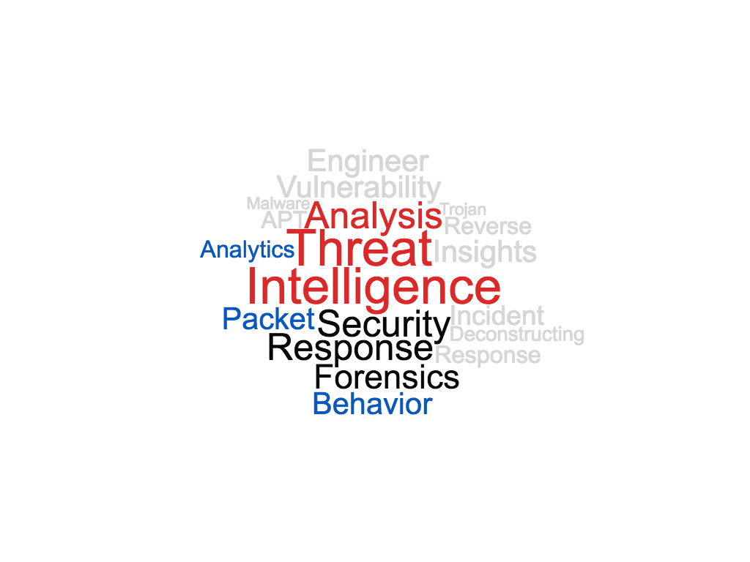
Introduction
Monty St John
25 years of security, digital forensics, reverse engineering, threat intelligence
Two decades supporting federal, state, and local LE while in uniform
Forensics and Threat Intelligence
Last decade acting as a key member of IR and TI teams deconstructing, analyzing and providing insights into threats and how to thwart them

Slide 3

Knowledge is having the right answer.
Intelligence is having the right questions.

Slide 4
Involved in the same activities
Action | DLP | Threat Intelligence
Alert | X | X
Investigate | X | X
Research |  | X
Profile | X | X
Behavior Analytics | X | X
Compliance | X
Prevention | X | X
Security | X | X
Monitoring | X | X
Document Incidents | X | X
Communication | X | X

Slide 6
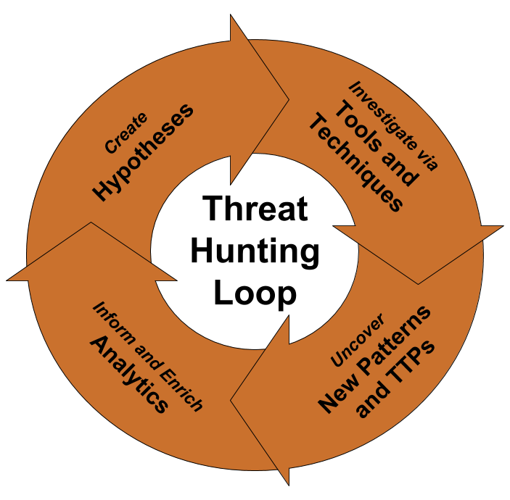
Notes:
Imaged sourced from http://blog.sqrrl.com/the-threat-hunting-reference-model-part-2-the-hunting-loop

Slide 7
SOC is the fusion center and takes action on items and engages incidence response as needed
DLP feeds the SOC and also feeds data back to TI
TI feeds the SOC and also feeds data back to DLP

Slide 8


Slide 9


Slide 10
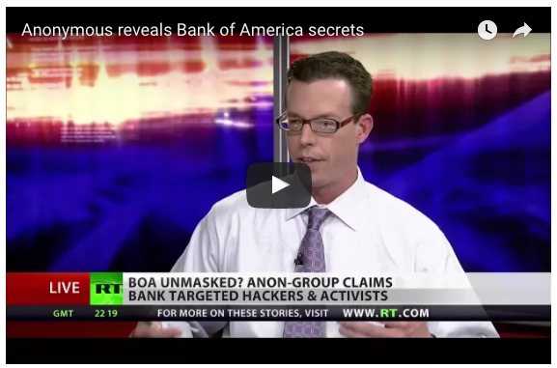
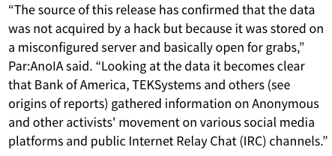
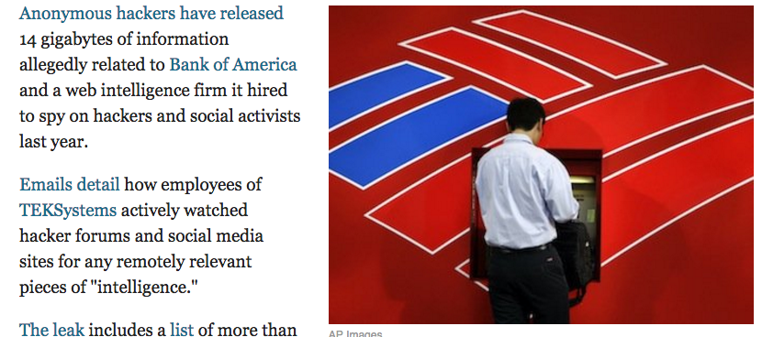

Slide 11
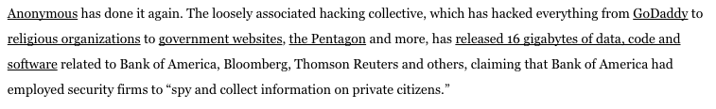
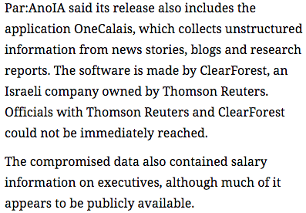
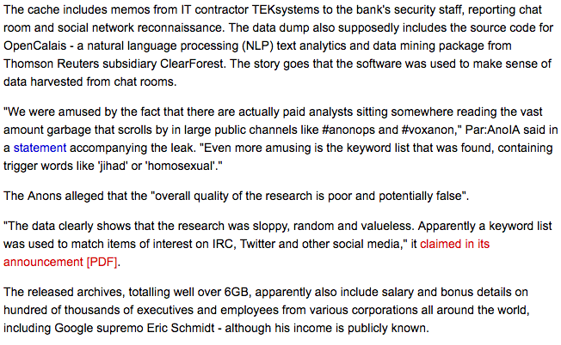


Slide 12



Slide 13
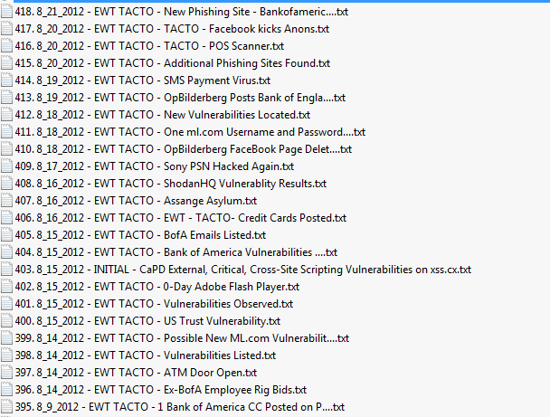
Internal emails
Details on internal programs
Salary information on executives
Intelligence reports
Questions executives were seeking answers to
Observations on people
Hundreds of other emails

